Slide 1
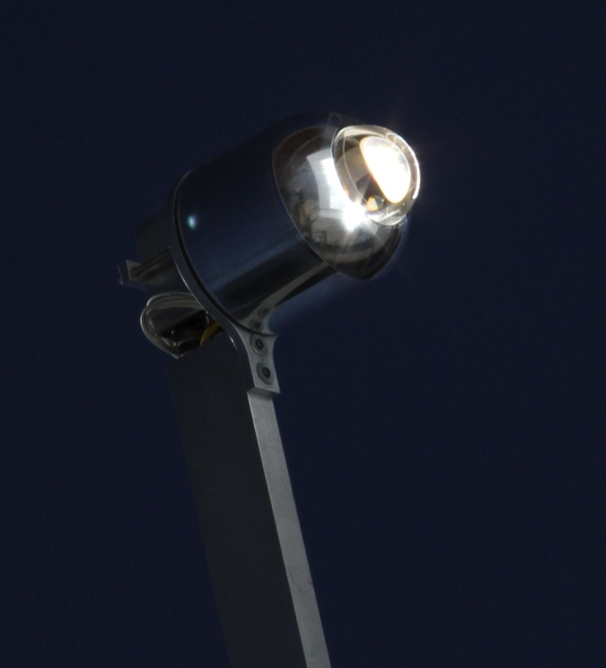





Increasing Light Absorption in Concentrating Photovoltaic System Through Use of Anti- Reflective Sol-gel Coated Ball Lens
Safatul Islam
Mentor: Roger Angel
Steward Observatory Solar Lab

Slide 2
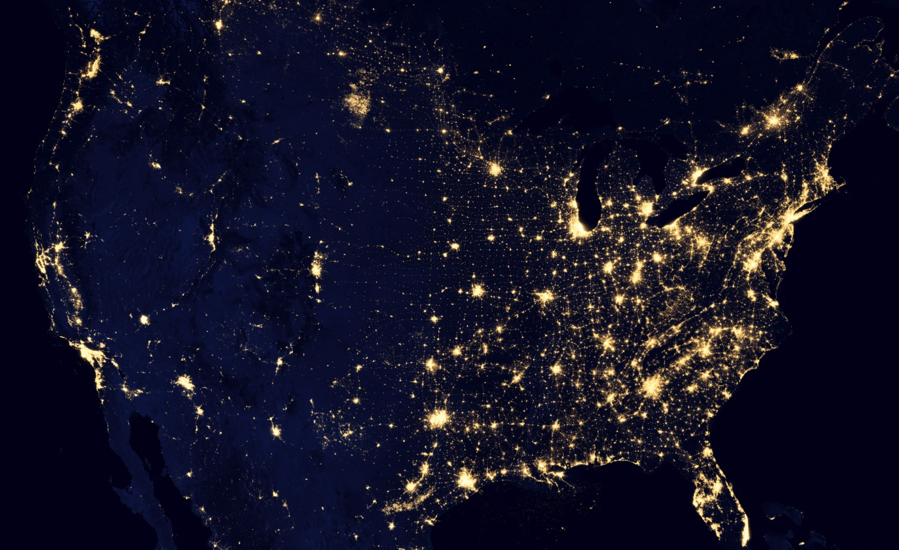
Introduction
http://www.nasa.gov

Slide 3
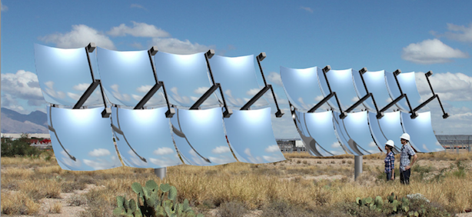
Concentrated Photovoltaics
Solar tracker system with paraboloidal mirrors concentrate onto focal point
  1000x suns
Light energy is transformed to electricity

Slide 4
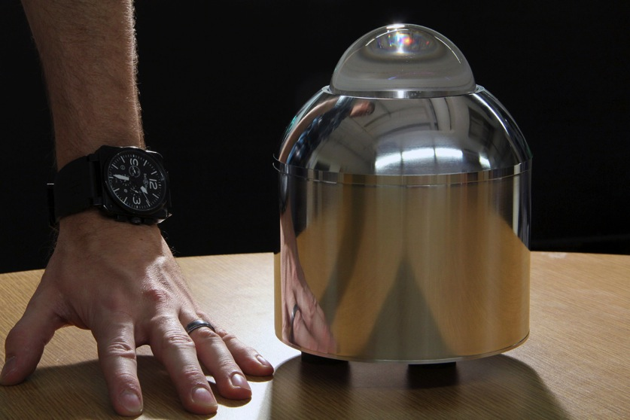
Power Conversion Unit
800 W module
  Ultimately sell for less than $1 per watt

Slide 5
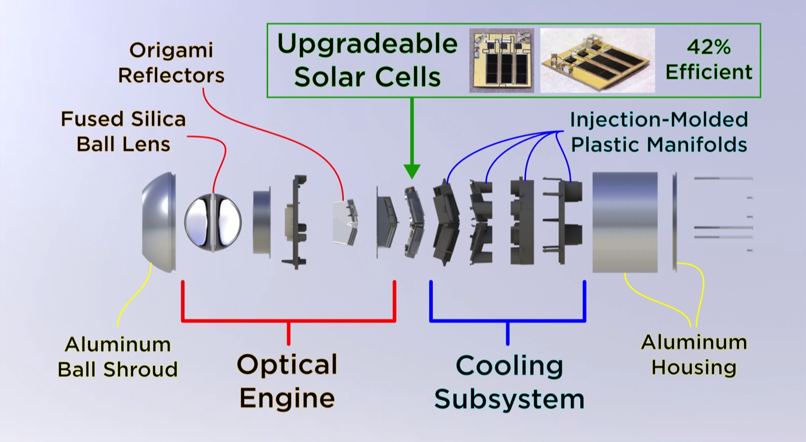
Power Conversion Unit

Slide 6
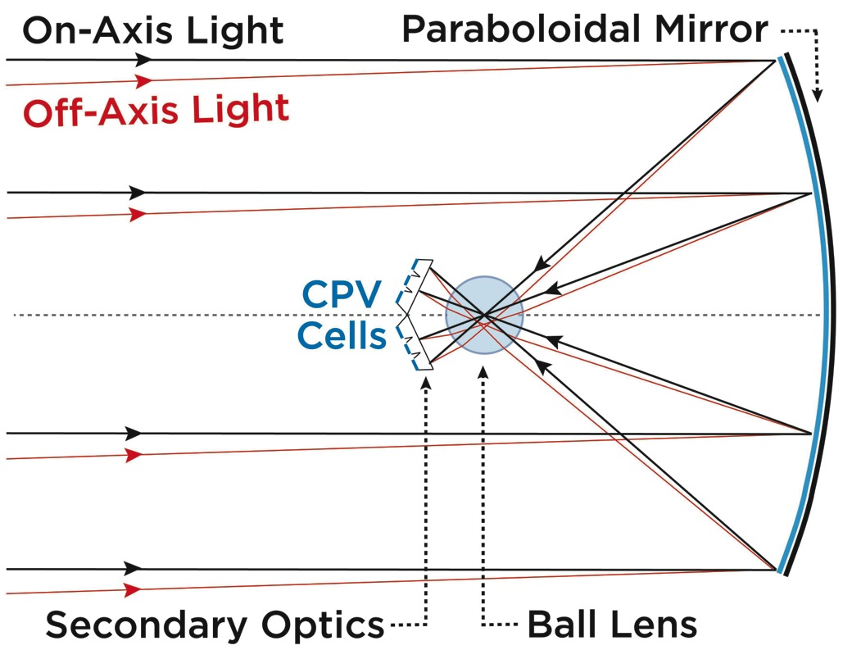
Ball Lens

Slide 7
Objectives
Need for Anti-Reflective coating
  Sol-gel
Overcoming spherical geometry
How can a thin film of Sol-gel be successfully coated onto a spherical ball lens?

Slide 8
Methods
Spin coating application
Set up of necessary equipment

Slide 9
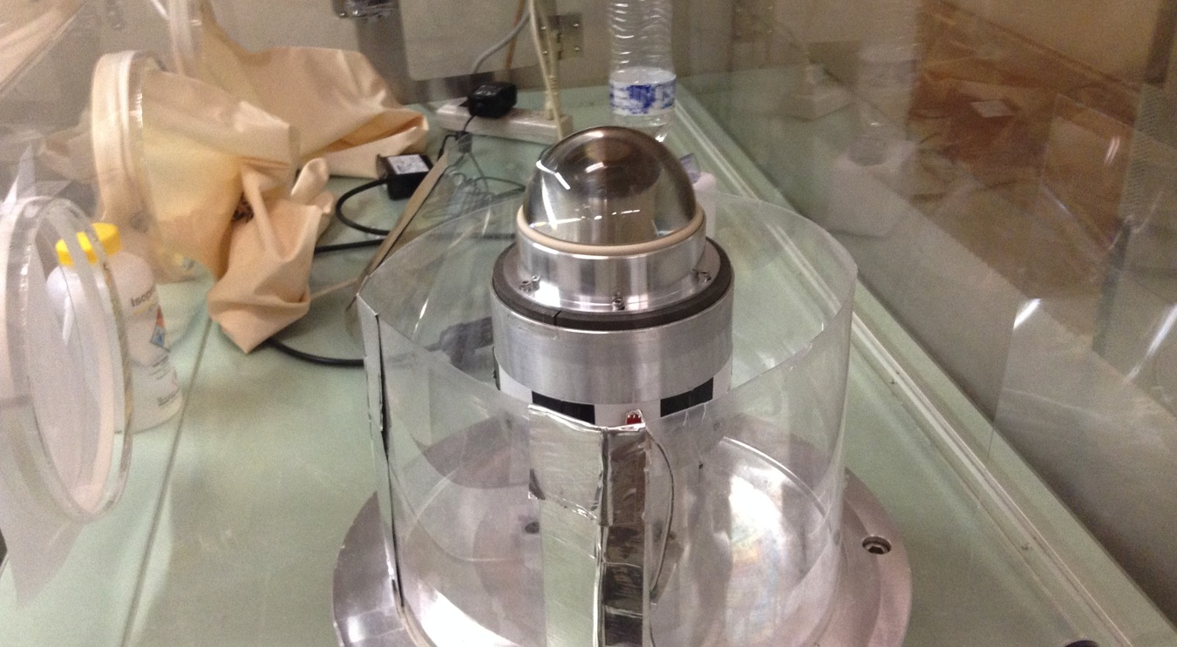
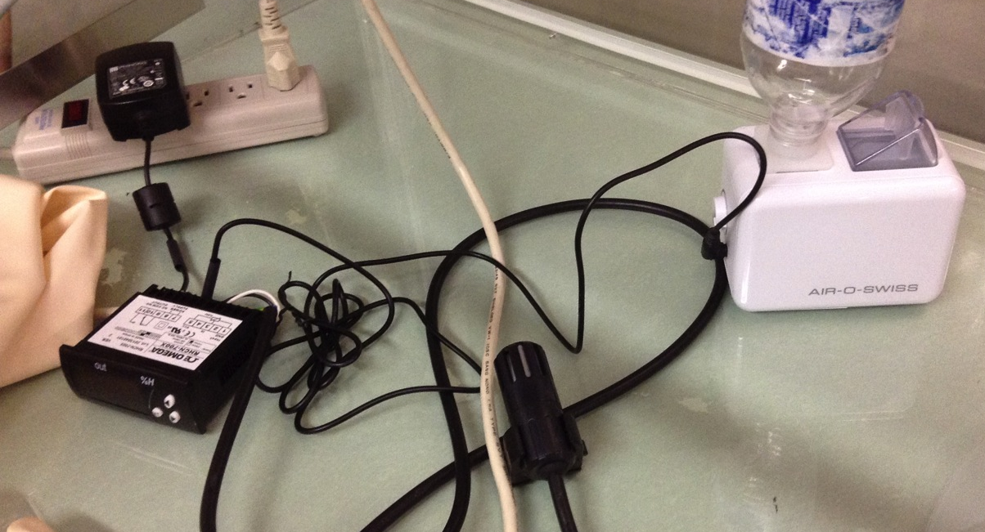
Humidity controlled glovebox environment

Slide 10
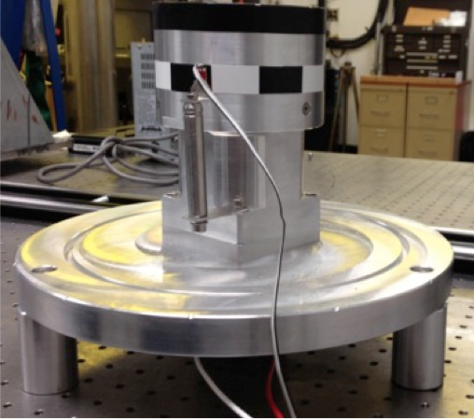
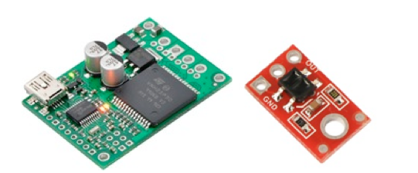
PID Controller to control spin rate

Slide 11
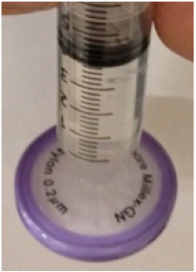
Syringe and filter for deposition

Slide 12
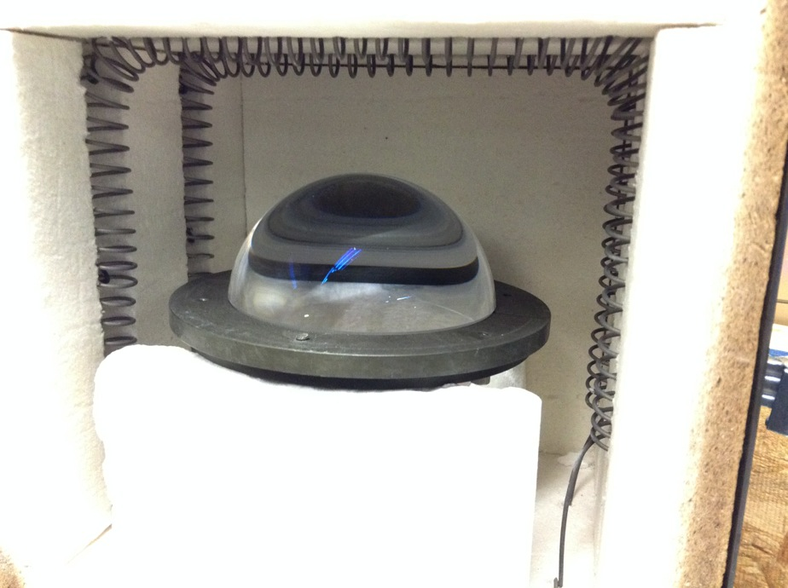
Table top furnace to fire coating

Slide 13
Variables Affecting Film Coating
Smoothness of ball surface
  Polishing
Cleanliness of ball surface
  Sonicating, organic solvents
Structural Support
Sol-gel filtration
Syringe Application
Spin Rate

Slide 14
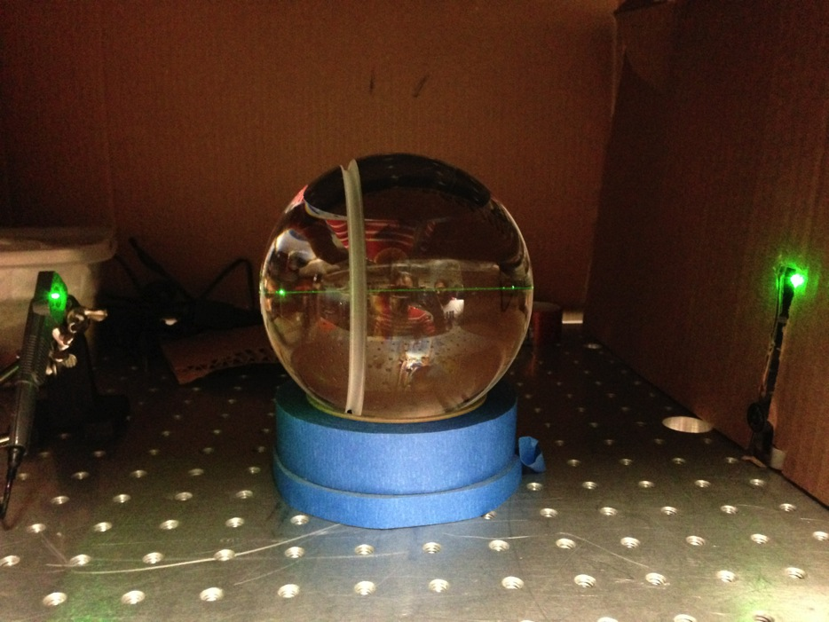
Transmission Testing

Slide 15
Results
From qualitative tests, coating was uniform throughout most of the ball
  Thinner at poles
Small area around the equator remained uncoated
Coating becomes thinner after firing
Few defects were noticeable
The coating functioned as desired

Slide 16
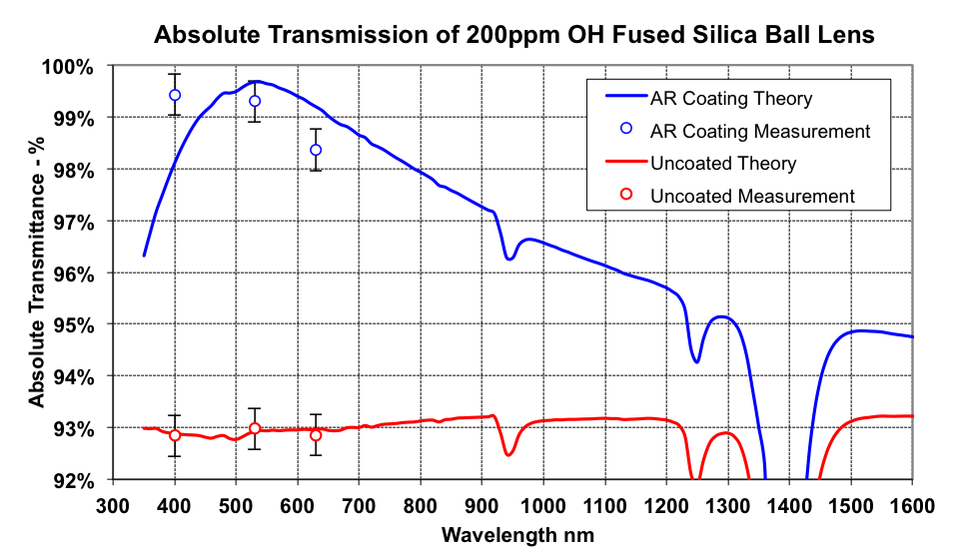
Results

Slide 17
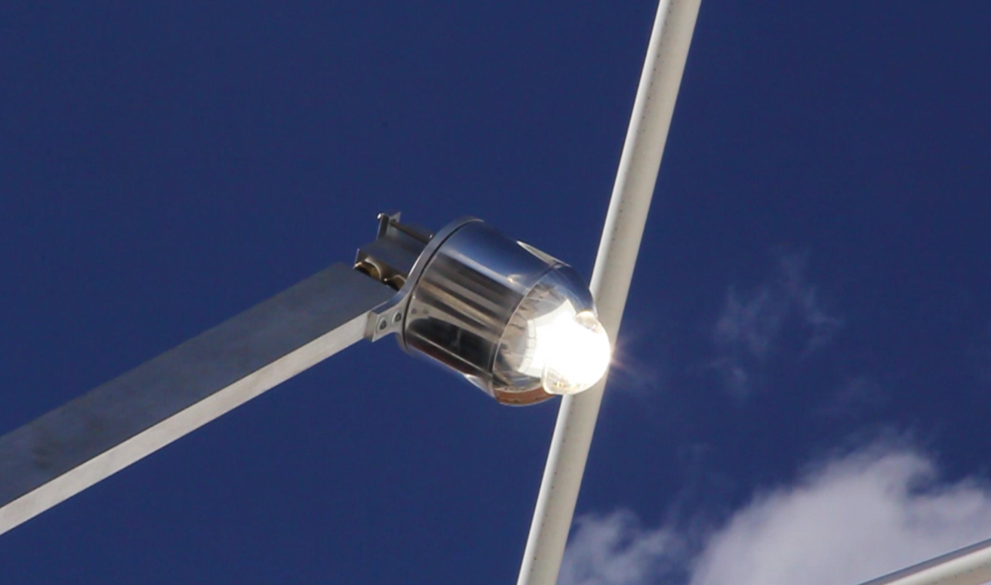

Slide 18




Acknowledgements
Steward Observatory Solar Lab
  Dr. Roger Angel
  Dr. Thomas Stalcup
  Blake Coughenour
  Brian Wheelwright
  Andrew Geary
UA/NASA Space Grant Program
  Susan Brew

Slide 19
Extra Slides

Slide 20
Future Considerations
Eliminate some of the defects
  Automated cleaning and depositing apparatus
  Better support to hold and transfer ball lens
Other methods of coating
  Vacuum sputtering

Slide 21
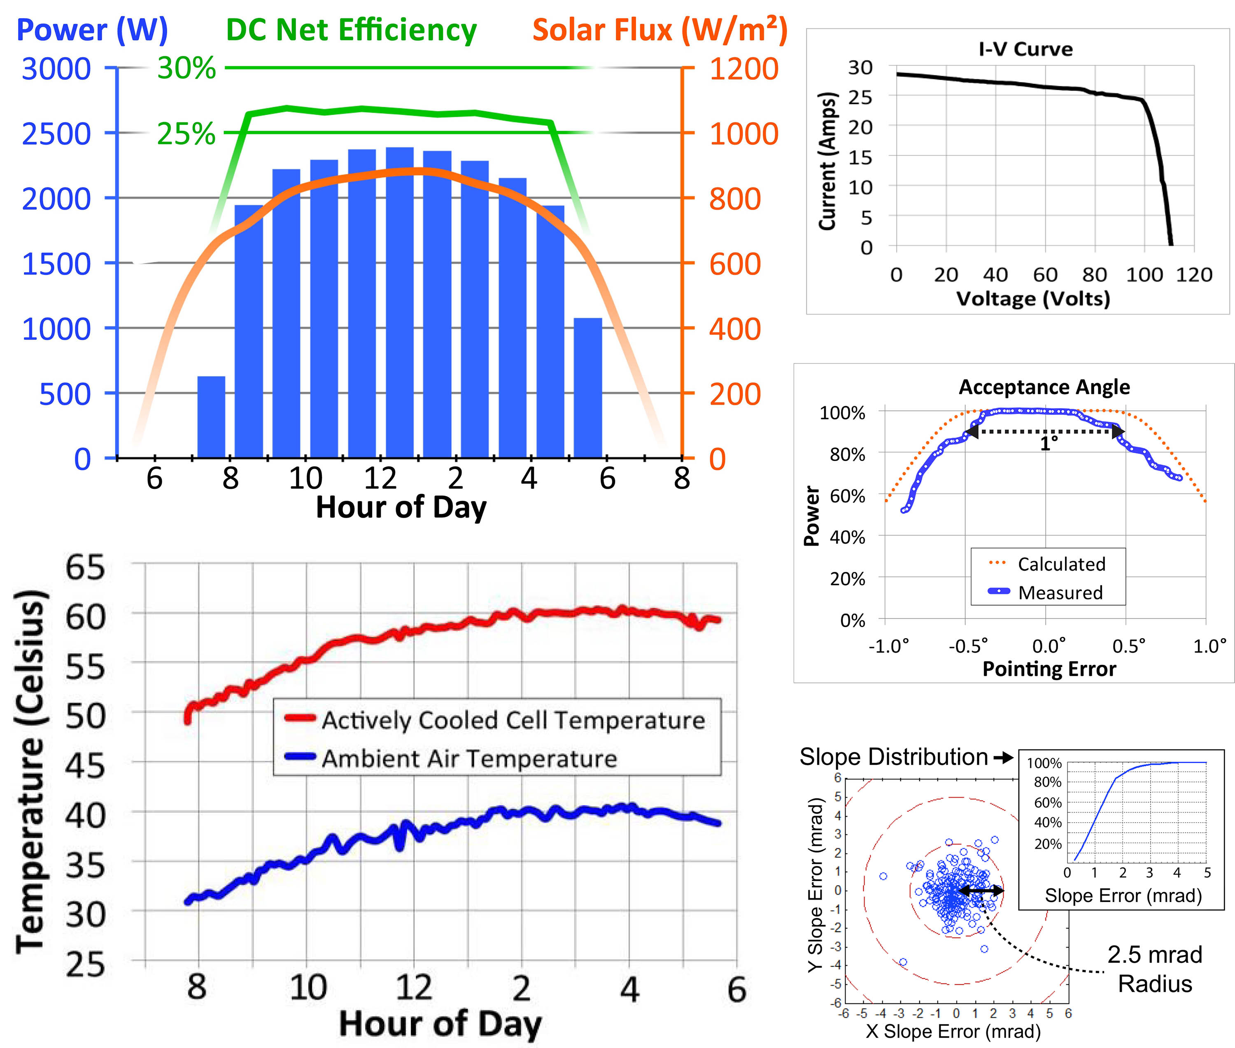
PCU Results

Slide 22
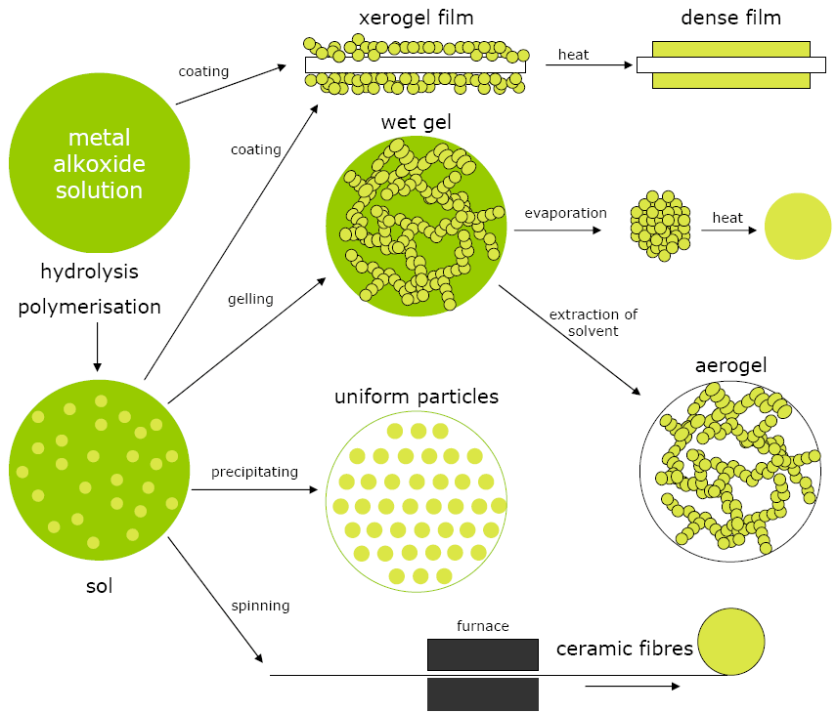
Sol-gel
http://www.centexbel.be

